Slide 1
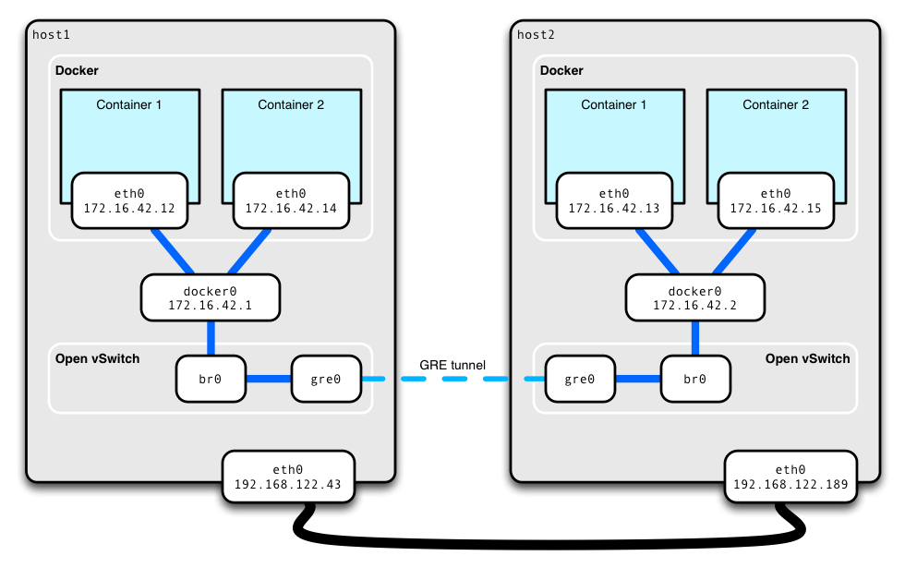
Docker Networking

Slide 2
Network drivers
Bridge – Default Network Driver, facilitate communication
Host – use the host’s networking directly
None – To disable all networking
Overlay – Used for commination between two docker host(used in swarm service)

Slide 3
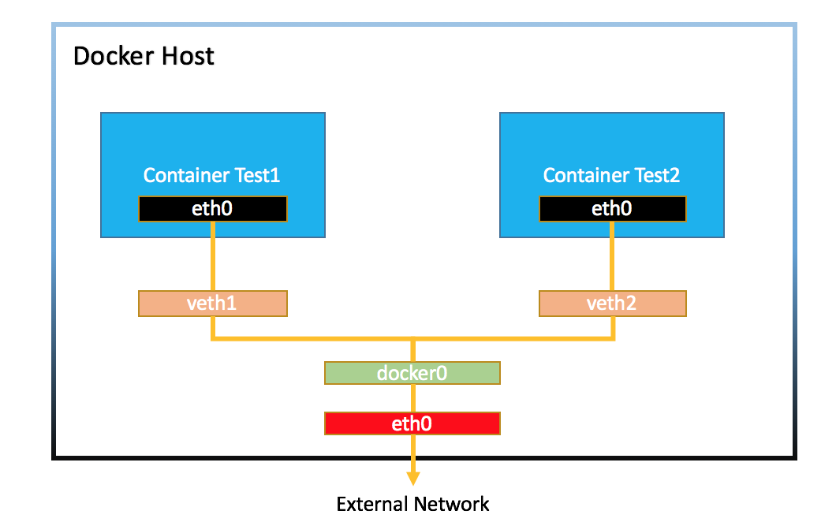
Bridge Network

Slide 4
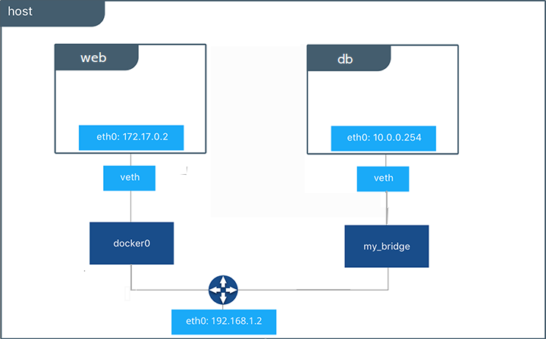
User defined bridge network

Slide 5
How to create user defined subnet ?

Slide 6
How to set static IP address to the Container ?

Slide 7
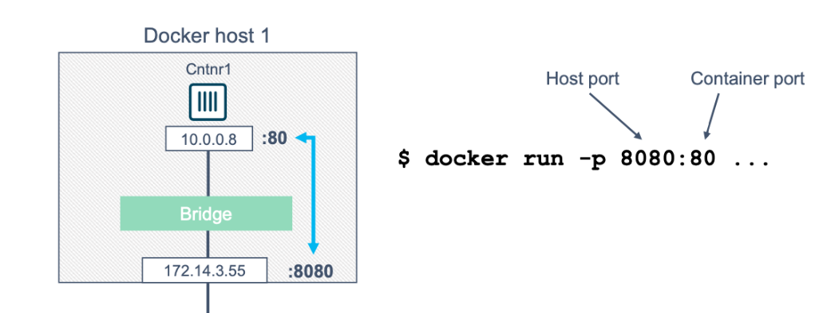
What is Port forwarding and why do we need it?

